Slide 1
Single-Source Shortest Paths
CLRS Chapter 24.1, 24.2

Slide 2
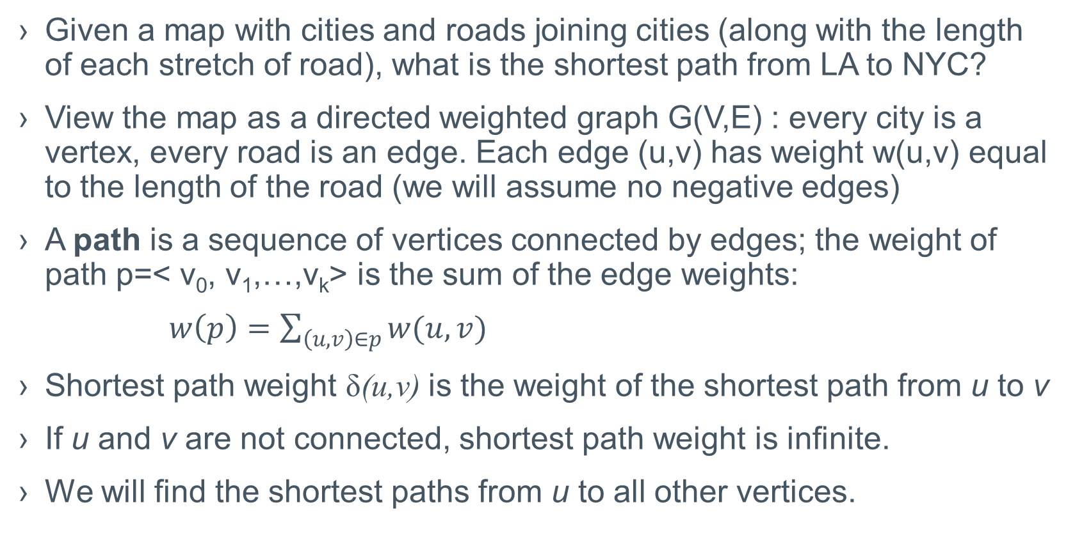
Single-Source Shortest Paths
Given a map with cities and roads joining cities (along with the length of each stretch of road), what is the shortest path from LA to NYC?
View the map as a directed weighted graph G(V,E) : every city is a vertex, every road is an edge. Each edge (u,v) has weight w(u,v) equal to the length of the road (we will assume no negative edges)
A path is a sequence of vertices connected by edges; the weight of path p=< v₀, v₁,…,v_{k}> is the sum of the edge weights:
$w\left(p\right)=\sum_{\left(u,v\right)∈p}{w(u,v)}$
Shortest path weight δ(u,v) is the weight of the shortest path from u to v
If u and v are not connected, shortest path weight is infinite.
We will find the shortest paths from u to all other vertices.

Slide 3
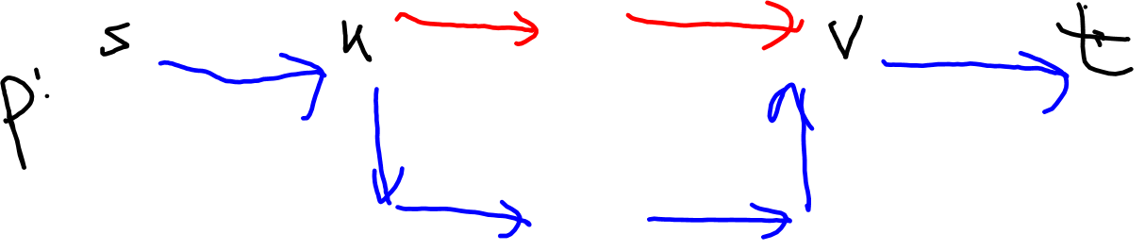
SSSP Properties
Optimal substructure of a shortest path:
Lemma: Subpaths of a shortest path p is a shortest path.
Proof: If not, remove the suboptimal subpath from p, replace it with the better one to obtain path p’ such that w(p’)<w(p). But then p cannot have been the SP.

Slide 4
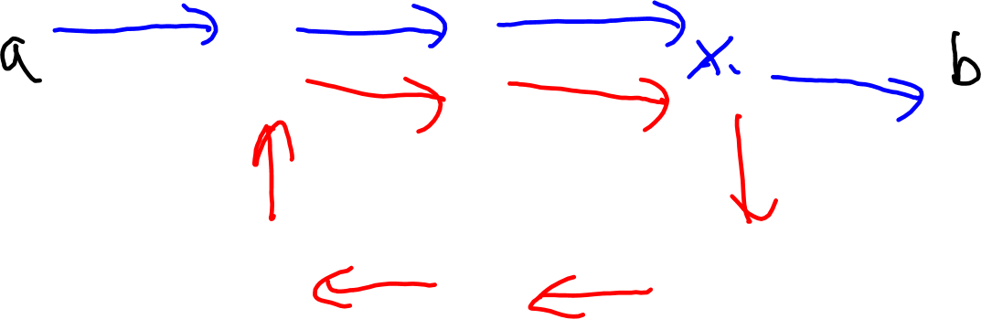
More SSSP Properties
A shortest path cannot contain a cycle.
Why? A cycle has positive weight, cutting it out will improve the path.

Slide 5
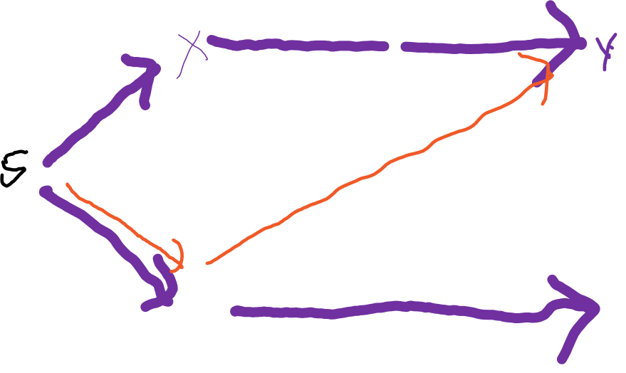
Shortest Paths Tree
We have a single source, s.
A Shortest Path Tree(SPT) rooted at s is a subgraph of G that represents the shortest weights from s to the other nodes.
6
3
2
1
4
2
7
3
5
6

Slide 6
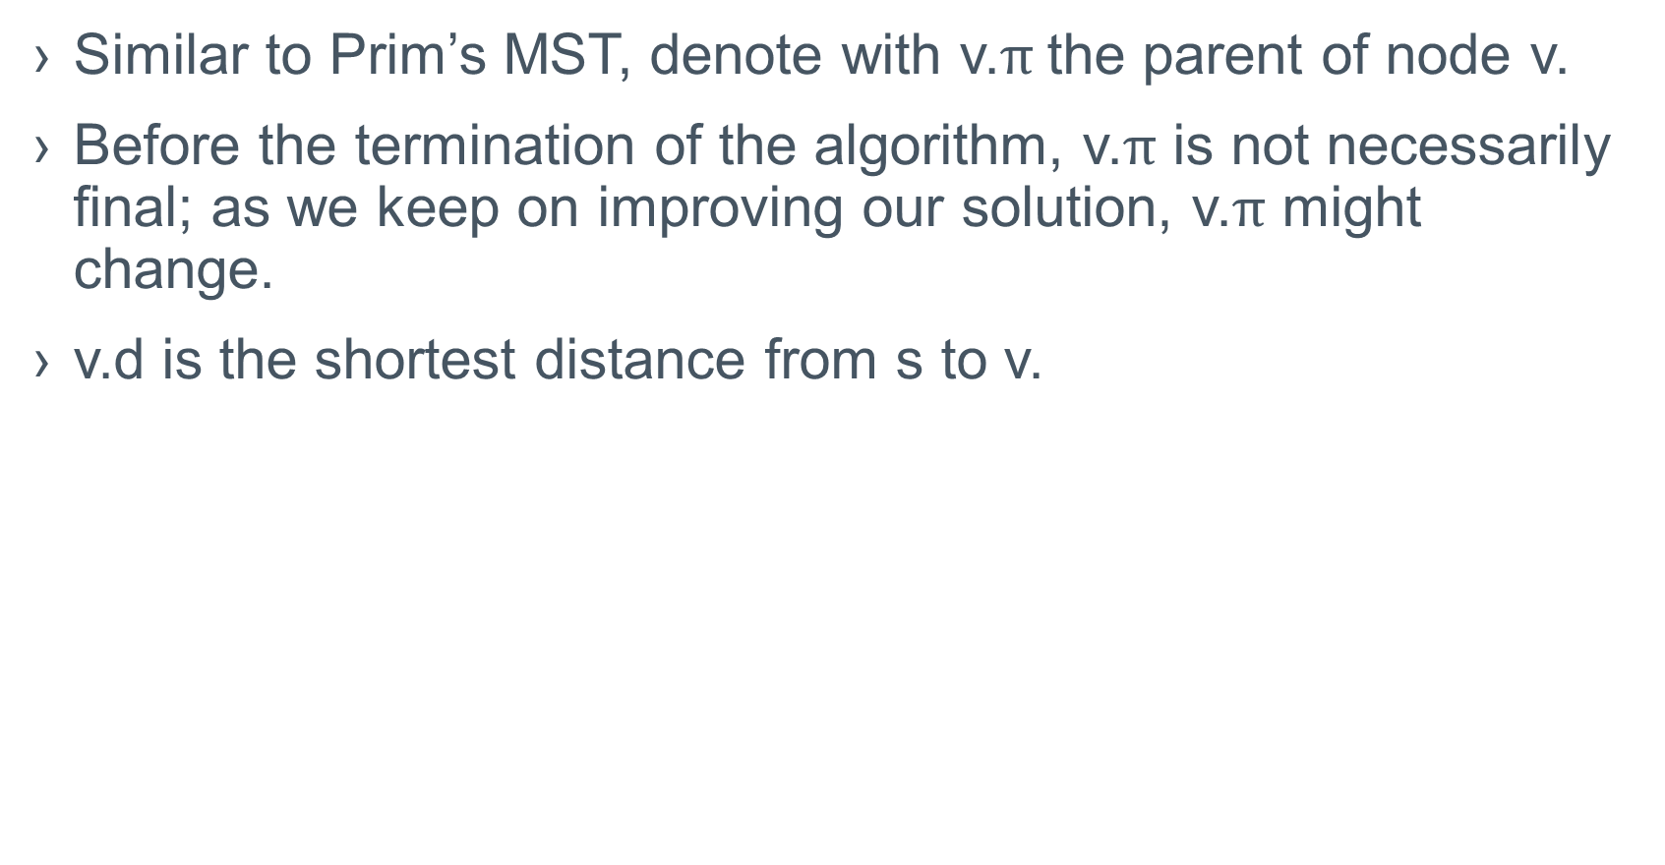
Representing Shortest Paths Trees
Similar to Prim’s MST, denote with v.$π$the parent of node v.
Before the termination of the algorithm, v.$π$ is not necessarily final; as we keep on improving our solution, v.$π$ might change.
v.d is the shortest distance from s to v.

Slide 7
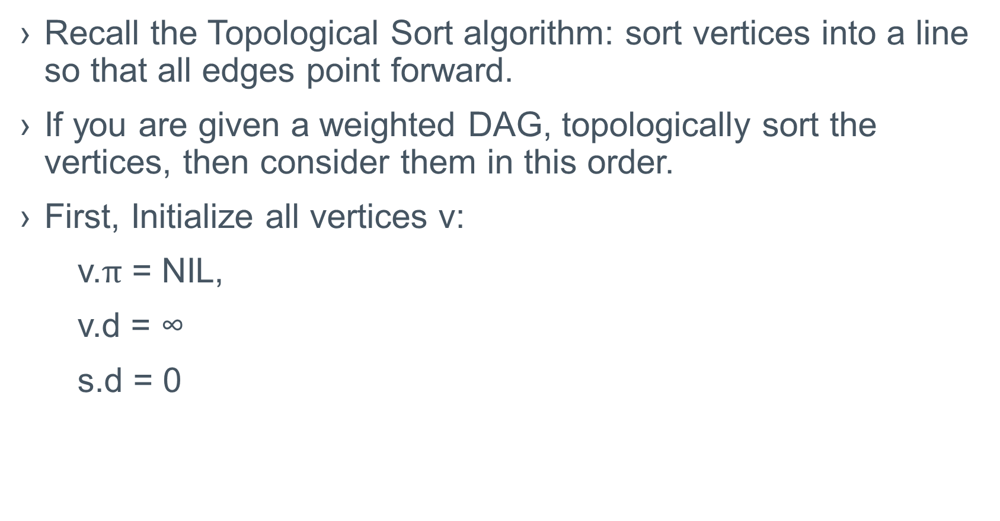
SSSP in Directed Acyclic Graphs
Recall the Topological Sort algorithm: sort vertices into a line so that all edges point forward.
If you are given a weighted DAG, topologically sort the vertices, then consider them in this order.
First, Initialize all vertices v:
v.$π$ = NIL,
v.d = ∞
s.d = 0

Slide 8
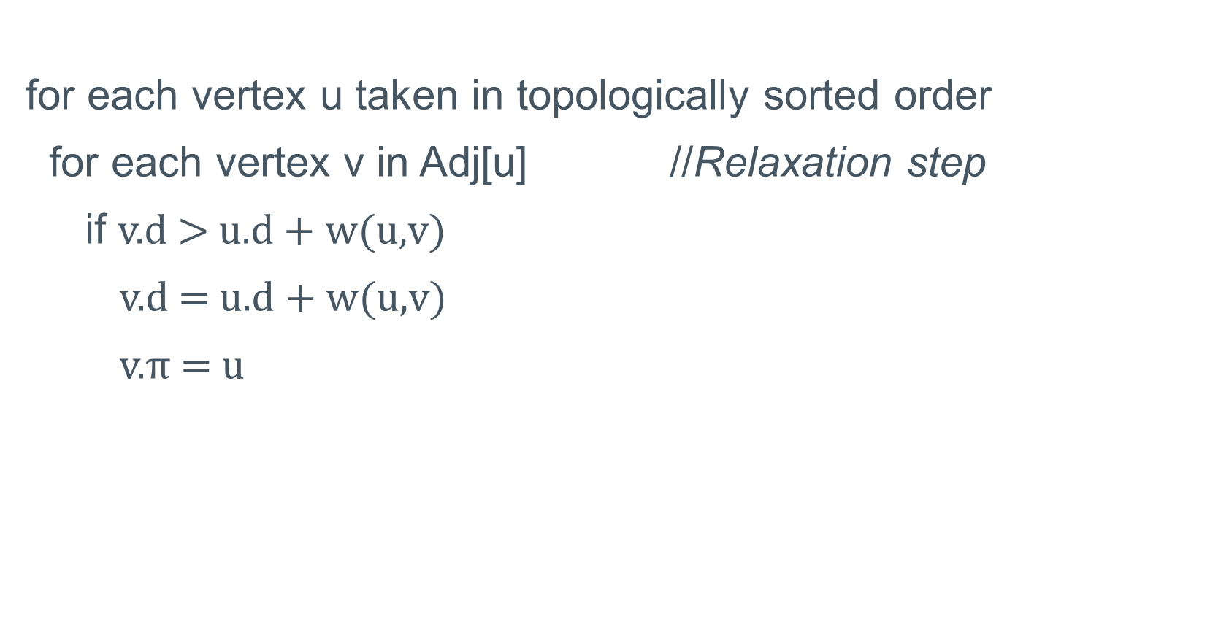
SSSP in Directed Acyclic Graphs
for each vertex u taken in topologically sorted order
for each vertex v in Adj[u] //Relaxation step
if v.d > u.d + w(u,v)
v.d = u.d + w(u,v)
v.$π$ = u

Slide 9
Path Relaxation Property (p. 673)
start off by initializing G
Let p= =< v₀, v₁,…,v_{k}> be a SP from s=v₀ to v_{k}.
Then, if the relaxation steps in an algorithm follow the order (v₀,v₁),(v₁,v₂),…,(v_{k-1}, v_{k}) with other edges mixed in, then, after the relaxation of (v_{k-1}, v_{k}) we have the correct answer for the SP between v_{1 and} v_{k}
Proof: by induction on the edges in the path.

Slide 10
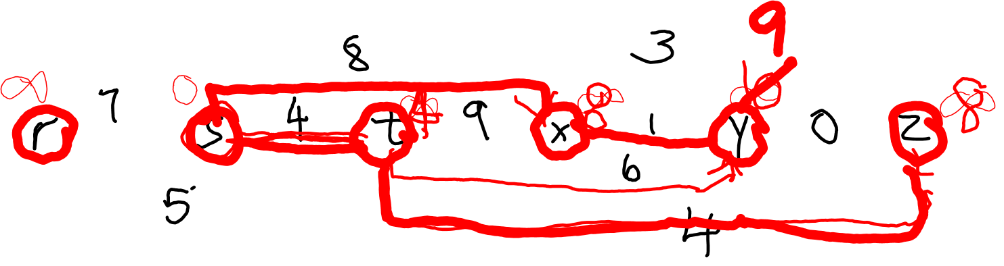
SSSP on a DAG, example

Slide 11
Why This Algorithm Works, Running Time
Let p be a shortest path from s to some vertex v.
The edges of p respect topological order.
By the path-relaxation property, the correct paths are found.
Running time: topological sort + |E| relaxations, O(|V|+|E|)

